Slide 1

MSc. In Data Science and Analytics
DSA 8401: Applied Machine Learning Assignment
106218 - Gertrude Gichuhi
Housing Project
28th/08/2022

Slide 2
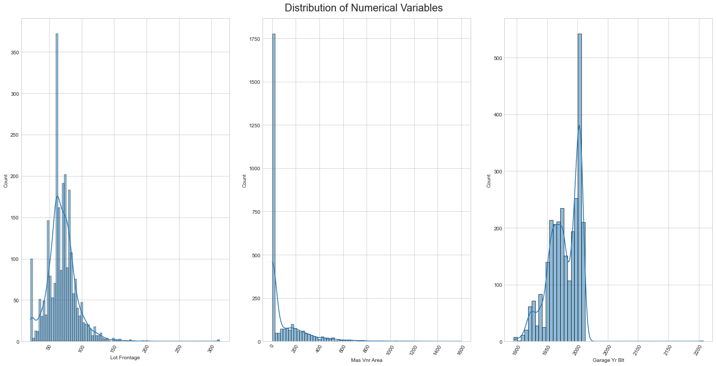
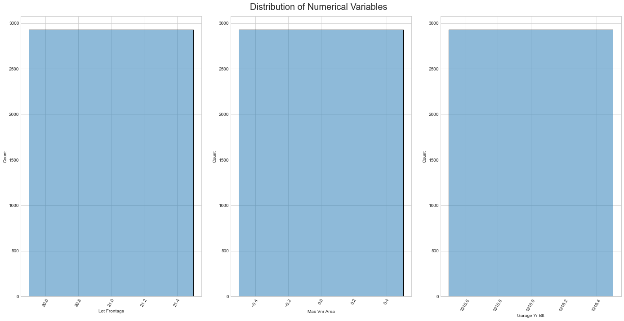
Understanding the Data & Performing EDA
General information about the dataset
Shape -The Dataset has 2930 rows and 82 columns
After examining columns Order and PID, I conclude that they can be used since they act as the Metadata, meaning they are the input elements that describe things, answering questions such as when it was bought etc.
To impute, I implemented winsorization through Normalization with limits of [.01,.99], meaning that extreme values will lie within the limits set

Slide 3
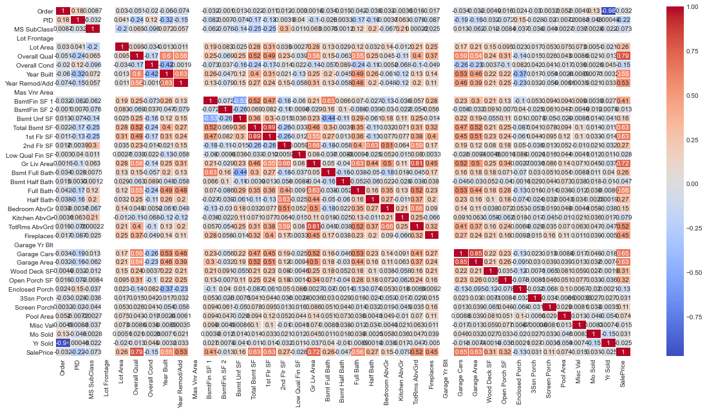
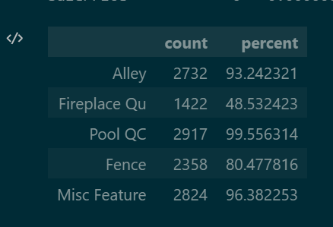
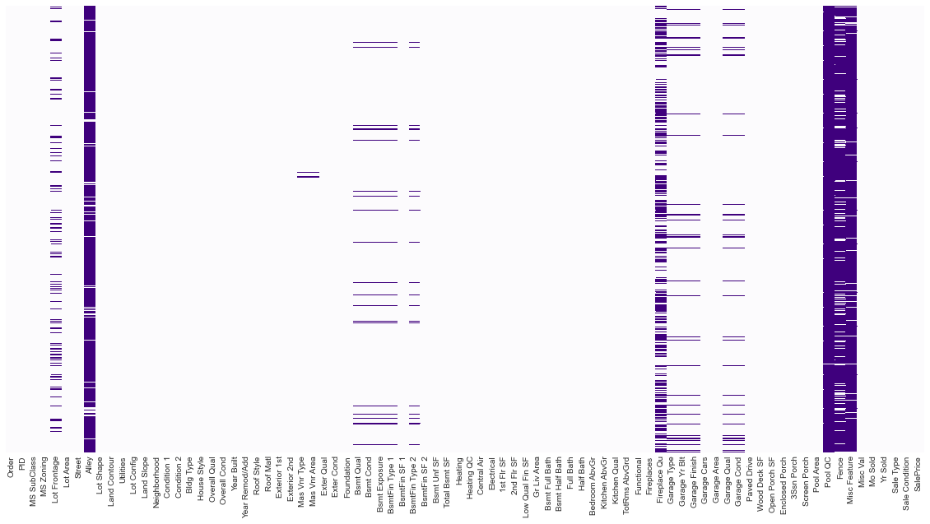
Exploratory Data Analysis
Missing Values in both Numerical and Categorical
The top three features with the highest number of missing values are the Alley, Fireplace Qu, and the Pool QC.
To handle them, I have dropped the columns with the missing values.
The heatmap in purple shows the missing values, the multicolored heatmap shows columns after the missing values are handled. The diagram in the middle shows the summary of the missing values

Slide 4
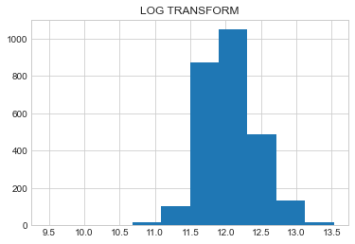
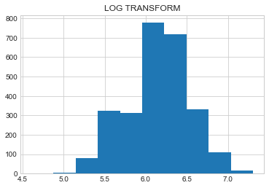
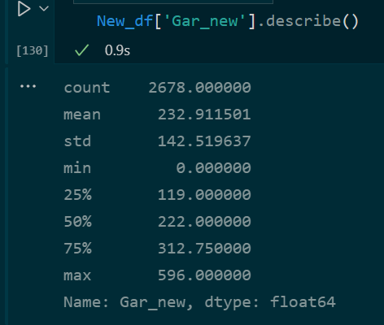
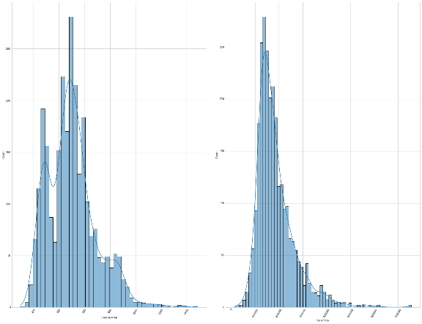
Feature Analysis
The two highly skewed numerical features are
Garage area
Sales Price
The best transformations that I finally picked was the log transformation to remove the skewness in both features. However, there are still outliers.
Cardinality
The three features with the most top cardinalities are:
Neighborhood -28
Exterior 2nd- 16
MS SubClass -16
To convert the categorical data to numerical we will use LabelEncoder from sklearn library, with fit_transform()
I performed the one-hotencode and got the min as 0, Max as 596, and mean as 232.912

Slide 5
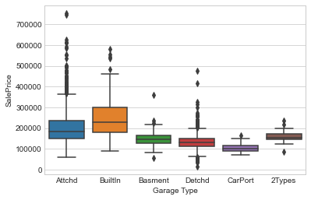
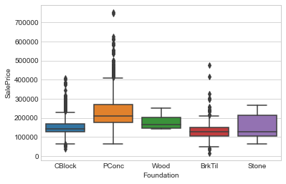
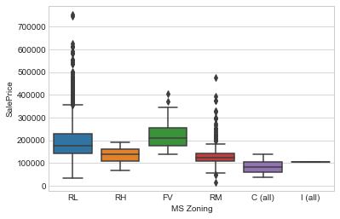
Bivariate Analysis Perform a bivariate analysis (box plots) of these features ('MS Zoning', 'Foundation','Garage Type') versus the 'SalePrice’.
Though there are a number of outliers, the feature that I believe to be more important in predicting the sale price is the Garage Type, since there is a threshold of at least above 200000, or below.

Slide 6
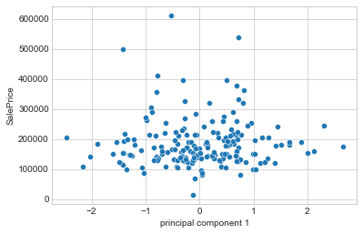
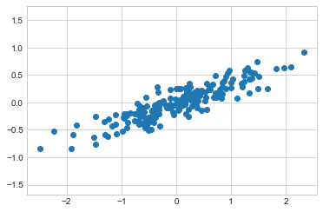
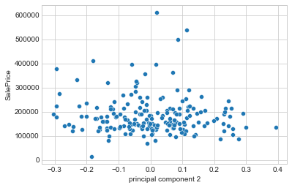
Principal Component Analysis (PCA)
This is a 2dimensionality principal component.
The other two represent component 1 & 2 against SalePrice. Component 1 has a higher correlation to SalePrice.

